Slide 1
Fundamentals of Internet Programming
Chapter 2 – hypertext markup language (html)

Slide 2
Contents
Introduction to HyperText Markup Language (HTML)
What is HyperText?
What is Markup Language
Editors
What are HTML Element?
What is Attributes?
Basics
HTML Headings
HTML Paragraphs
HTML Styles
HTML Formatting
HTML Quotations
HTML Comments
HTML colors
HTML Links
HTML Images
HTML Favicon
HTML Page Title

Slide 3
Contents…
HTML Tables
HTML Lists
HTML Block & Inline
HTML Iframes
HTML Head
HTML Computercode
HTML Semantics
HTML Entities
HTML Symbols
HTML Emojis
HTML Forms
HTML Form Attributes
HTML Form Elements

Slide 4
Contents ….
HTML Input Types
HTML Input Attributes
HTML Input Form Attributes
HTML SVG
HTML Media
HTML Video
HTML Audio
HTML Web Storage

Slide 5
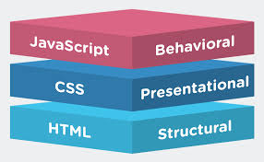
Introduction to HyperText Markup Language(HTML)
The HyperText Markup Language or HTML is the standard markup language for documents designed to be displayed in a web browser.
It defines the meaning and structure of web content.
HTML consists of a series of elements
It is often assisted by technologies such as
Cascading Style Sheets (CSS) and
scripting languages such as JavaScript.

Slide 6
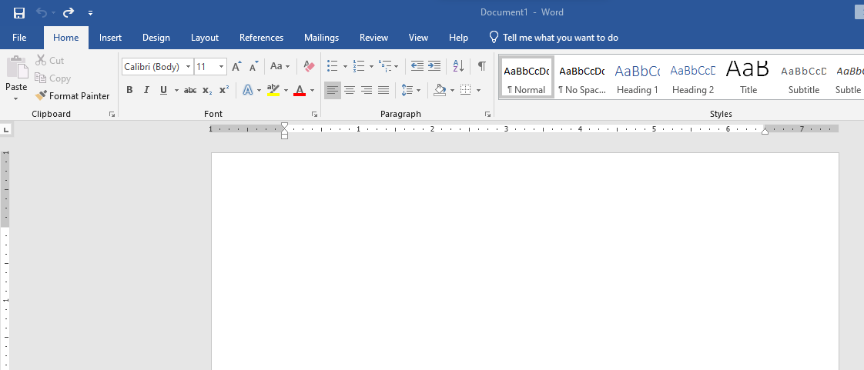
Markup Analogy …. Microsoft Word

Slide 7
What is Hypertext ?
Hypertext is text displayed on a computer display or other electronic devices with references (hyperlinks) to other text that the reader can immediately access.
Hypertext documents are interconnected by hyperlinks, which are typically activated by a mouse click, keypress set, or screen touch.
Notes:
In computing, a hyperlink, or simply a link, is a digital reference to data that the user can follow or be guided to by clicking or tapping. A hyperlink points to a whole document or to a specific element within a document. Hypertext is text with hyperlinks. The text that is linked from is known as anchor text.

Slide 8

What is Markup Language ?
A markup language is a text-encoding system consisting of a set of symbols inserted in a text document to control its structure, formatting, or the relationship between its parts.
Markup is often used to control the display of the document or to enrich its content to facilitate automated processing.
Some of Markup Languages are
Troff
TeX
LaTeX
Scrib
XML
HTML – widely used and have pre defined presentation semantics

Slide 9
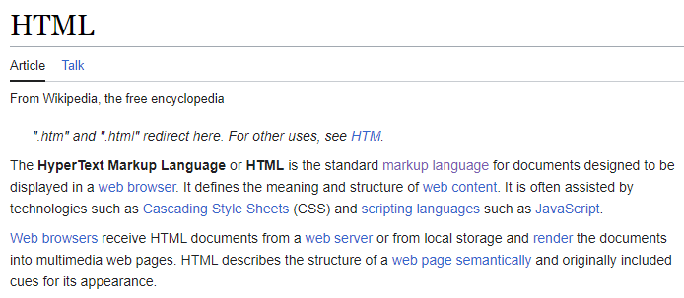
Markup Language …
HTML uses "markup" to annotate text, images, and other content for display in a Web browser.
E. g. Wiki HTML Definition uses , Italics, bold, quotation, to annotate the web page

Slide 10
HTML Editors
Some of HTML Editors which used for web development are the following…
NotePad(PC)
TextEdit(Mac)
NotePad+
Sublime(Platform independent)
Atom
Visual Code Studio
… etc

Slide 11
What are HTML Elements?
An HTML element is set off from other text in a document by "tags", which consist of the element name surrounded by "<" and ">".
The HTML element is everything from the start tag to the end tag:
<tagname> Content goes here... </tagname>
or <tagname /> =➔ for empty elements without end tag
HTML markup includes special "elements" such as <head>, <title>, <body>, <header>, <footer>, <article>, <section>, <p>, <div>, <span>, <img>, <aside>, <audio>, <canvas>, <datalist>, <details>, <embed>, <nav>, <search>, <output>, <progress>, <video>, <ul>, <ol>, <li> and many others.

Slide 12
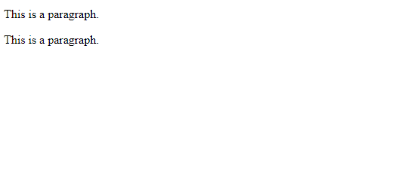
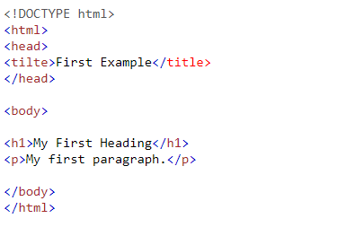
HTML Elements
The Result in Browser Window Looks Like
The following example contains Six HTML elements (<html>, <head> ,<title>, <body>, <h1> and <p>)

Slide 13
The name of an element inside a tag is case-insensitive. That is, it can be written in uppercase, lowercase, or a mixture.
For example, the <title> tag can be written as <Title>, <TITLE>, or in any other way.
However, the convention and recommended practice is to write tags in lowercase.
HTML elements can be nested (this means that elements can contain other elements).
All HTML documents consist of nested HTML elements.

Slide 14
What is HTML Attribute?
Elements in HTML have attributes; these are additional values that configure the elements or adjust their behavior in various ways to meet the criteria the users want.
All HTML elements can have attributes
Attributes provide additional information about elements
Attributes are always specified in the start tag
Attributes usually come in name/value pairs like: name="value"

Slide 15
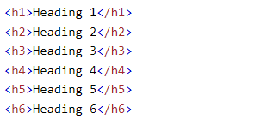
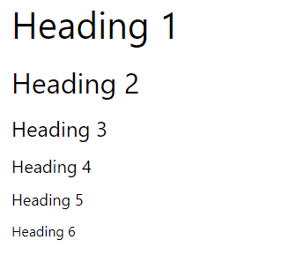
HTML Headings
HTML headings are titles or subtitles that you want to display on a webpage.
HTML headings are defined with the <h1> to <h6> tags.
Notes:
Search engines use the headings to index the structure and content of your web pages.
Each HTML heading has a default size. However, you can specify the size for any heading with the style attribute, using the CSS font-size property:
Users often skim a page by its headings. It is important to use headings to show the document structure.

Slide 16

HTML Paragraphs
A paragraph always starts on a new line, and is usually a block of text.
The HTML <p> element defines a paragraph.
A paragraph always starts on a new line, and browsers automatically add some white space (a margin) before and after a paragraph.

Slide 17
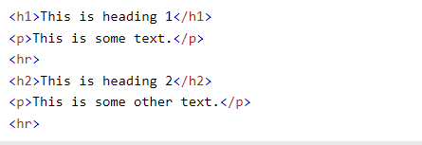
HTML Horizontal Rules
The <hr> tag defines a thematic break in an HTML page, and is most often displayed as a horizontal rule.
The <hr> element is used to separate content (or define a change) in an HTML page:
The <hr> tag is an empty tag, which means that it has no end tag.

Slide 18
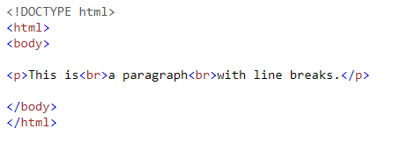
HTML Line Breaks <br> or <br />
The HTML <br> element defines a line break.
Use <br> if you want a line break (a new line) without starting a new paragraph:

Slide 19

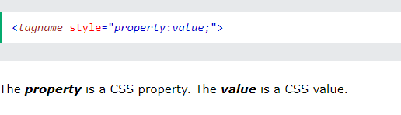
HTML Style Attribute
The HTML style attribute is used to add styles to an element, such as color, font, size, and more.
Setting the style of an HTML element, can be done with the style attribute.
The HTML style attribute has the following syntax:

Slide 20
HTML Style Attribute ….
Some property value examples
Property | Possible Values
background-color | Any valid HTML color(red, green, blue,….)
color (used for text ) | Any valid HTML color(red, green, blue,….)
font-family | Arial, verdana, courier, ….
font-size | We can give in px, em, rem or %
text-align (horizontal text alignment) | Center, left, right , justify

Slide 21
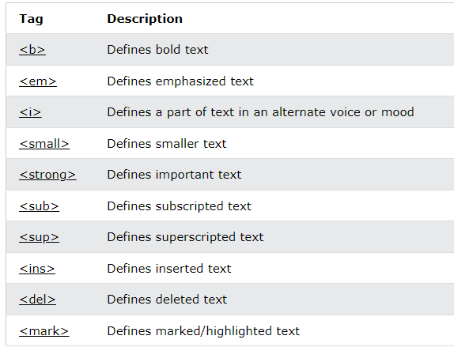
HTML Text Formatting
Notes:
The HTML <strong> element defines text with strong importance. The content inside is typically displayed in bold.
The HTML <em> element defines emphasized text. The content inside is typically displayed in italic.

Slide 22
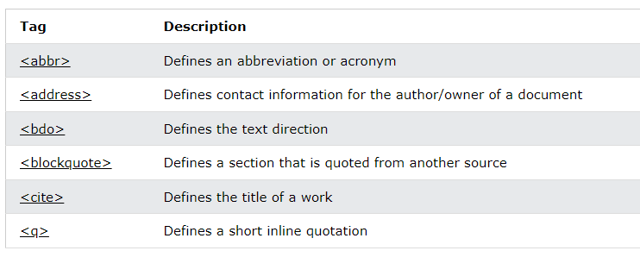
HTML Quotation and Citation Elements

Slide 23
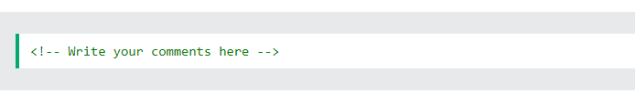
HTML Comments
HTML comments are not displayed in the browser, but they can help document your HTML source code
Comment Tag

Slide 24
HTML Colors
HTML colors are specified with predefined
Predefined color
RGB or RGBA
HEX
HSL or HSLA

Slide 25
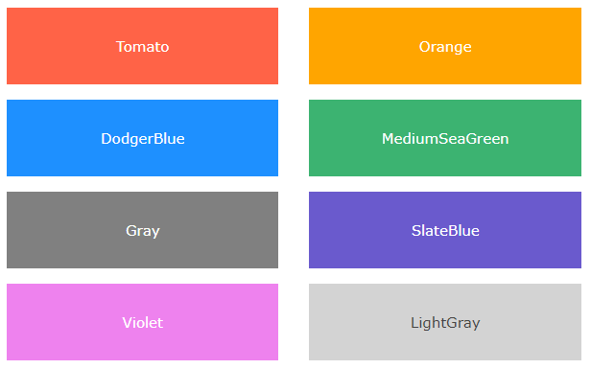

HTML Color …
In HTML, a color can be specified by using a color name
HTML supports 140 standard color name, such as

Slide 26
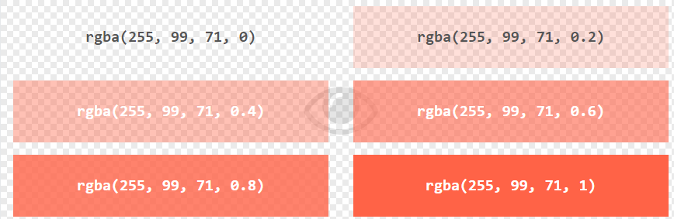
HTML RGB and RGBA Colors
An RGB or RGBA color value represents RED, GREEN, BLUE and Alpha light sources.
An RGBA color value is an extension of RGB with an Alpha channel (opacity).
The alpha parameter is a number between 0.0 (fully transparent) and 1.0 (not transparent at all):
In HTML, a color can be specified as an RGB value, using this formula:
rgb(red, green, blue) or rgba(red, green, blue, alpha)
Each parameter (red, green, and blue) defines the intensity of the color with a value between 0 and 255.
This means that there are 256 x 256 x 256 = 16777216 possible colors!

Slide 27
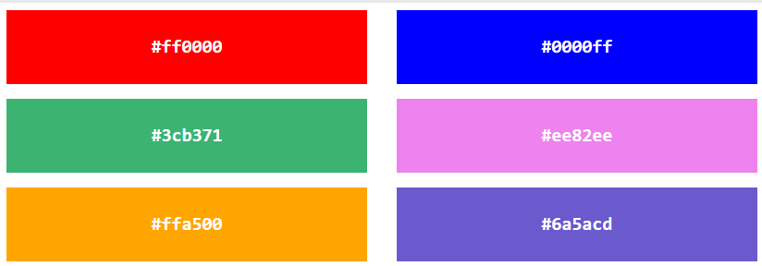
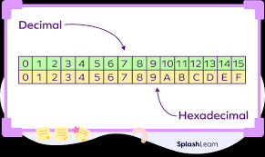
HTML HEX Colors
A hexadecimal color is specified with: #RRGGBB, where the RR (red), GG (green) and BB (blue) hexadecimal integers specify the components of the color.
In HTML, a color can be specified using a hexadecimal value in the form:
#rrggbb
Where rr (red), gg (green) and bb (blue) are hexadecimal values between 00 and ff (same as decimal 0-255).
For example, #ff0000 is displayed as red, because red is set to its highest value (ff), and the other two (green and blue) are set to 00.

Slide 28
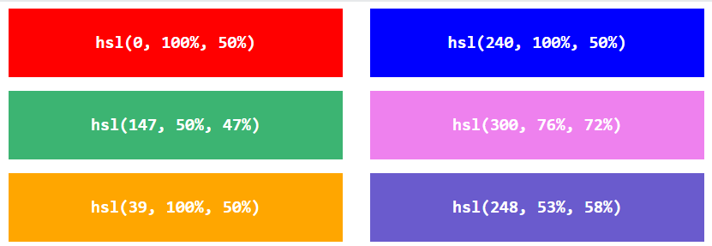
HTML HSL and HSLA Colors
HSL stands for hue, saturation, and lightness.
HSLA color values are an extension of HSL with an Alpha channel (opacity).
In HTML, a color can be specified using hue, saturation, and lightness (HSL) in the form:
hsl(hue, saturation, lightness)
Hue is a degree on the color wheel from 0 to 360. 0 is red, 120 is green, and 240 is blue.
Saturation is a percentage value. 0% means a shade of gray, and 100% is the full color.
Lightness is also a percentage value. 0% is black, and 100% is white.

Slide 29
HTML HSL Color …
Saturation
Saturation can be described as the intensity of a color.
100% is pure color, no shades of gray.
50% is 50% gray, but you can still see the color.
0% is completely gray; you can no longer see the color.
Lightness
The lightness of a color can be described as how much light you want to give the color, where 0% means no light (black), 50% means 50% light (neither dark nor light), and 100% means full lightness (white).

Slide 30
HTML Links
HTML links are hyperlinks.
You can click on a link and jump to another document.
When you move the mouse over a link, the mouse arrow will turn into a little hand.
HTML Links - Syntax
The HTML <a> tag defines a hyperlink. It has the following syntax:
<a href="url">link text</a>
The most important attribute of the <a> element is the href attribute, which indicates the link's destination.
The link text is the part that will be visible to the reader.

Slide 31
HTML Links …
By default, links will appear as follows in all browsers:
An unvisited link is underlined and blue
A visited link is underlined and purple
An active link is underlined and red
Example
<a href="https://www.w3.org/">W3C</a>

Slide 32
HTML Links attributes …
Attributes | Values
href | Html links you want to access
target | _self, _blank , _parent, _top
title | Extra information about an element

Slide 33


HTML Links - Create Bookmarks
HTML links can be used to create bookmarks, so that readers can jump to specific parts of a web page.
Bookmarks can be useful if a web page is very long.
To create a bookmark - first create the bookmark, then add a link to it.
When the link is clicked, the page will scroll down or up to the location with the bookmark.

Slide 34
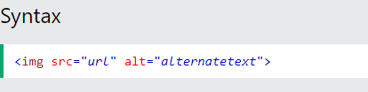
HTML Images
Images can improve the design and the appearance of a web page.
The HTML <img> tag is used to embed an image in a web page.
Images are not technically inserted into a web page; images are linked to web pages. The <img> tag creates a holding space for the referenced image.
The <img> tag has two required attributes:
src - Specifies the path to the image
alt - Specifies an alternate text for the image

Slide 35
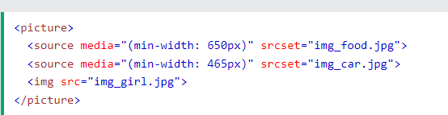
HTML <picture> Element
The HTML <picture> element allows you to display different pictures for different devices or screen sizes.
The HTML <picture> element gives web developers more flexibility in specifying image resources.
The <picture> element contains one or more <source> elements, each referring to different images through the srcset attribute.
This way the browser can choose the image that best fits the current view and/or device.
Each <source> element has a media attribute that defines when the image is the most suitable.

Slide 36
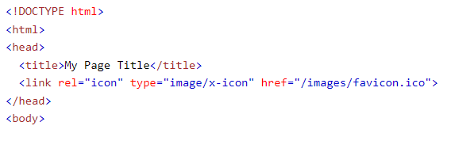
HTML Favicon
A favicon is a small image displayed next to the page title in the browser tab.
Tip: A favicon is a small image, so it should be a simple image with high contrast.

Slide 37
HTML Page Title
The <title> element adds a title to your page
The title should describe the content and the meaning of the page.
The page title is very important for search engine optimization (SEO).
The <title> element:
defines a title in the browser toolbar
provides a title for the page when it is added to favorites
displays a title for the page in search engine-results

Slide 38
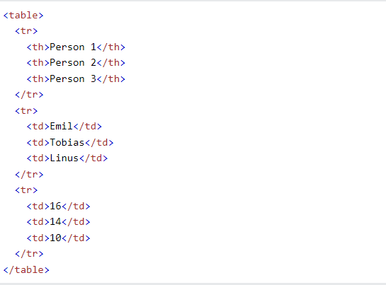
HTML Tables
HTML tables allow web developers to arrange data into rows and columns.
Each table cell is defined by a <td> and a </td> tag.
Note: A table cell can contain all sorts of HTML elements: text, images, lists, links, other tables, etc.
Each table row starts with a <tr> and ends with a </tr> tag.
Sometimes you want your cells to be table header cells. In those cases use the <th> tag instead of the <td> tag:

Slide 39
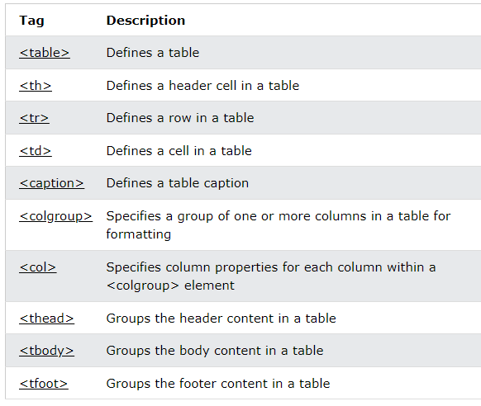
HTML Table …

Slide 40
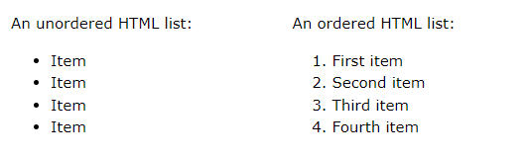
HTML Lists
HTML lists allow web developers to group a set of related items in lists.

Slide 41
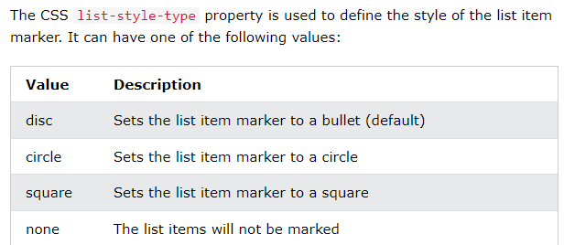
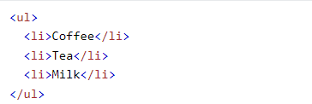
Unordered HTML List
An unordered list starts with the <ul> tag. Each list item starts with the <li> tag.
The list items will be marked with bullets (small black circles) by default:

Slide 42
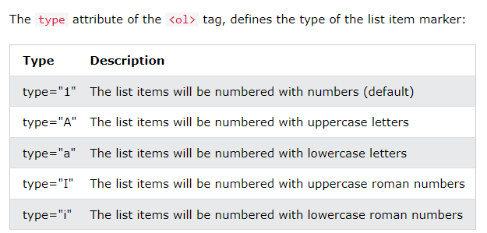
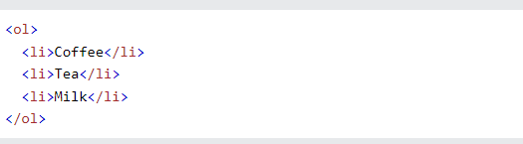
Ordered HTML List
An ordered list starts with the <ol> tag. Each list item starts with the <li> tag.
The list items will be marked with numbers by default:

Slide 43
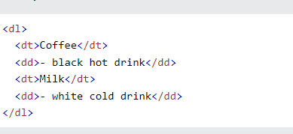
HTML Description Lists
HTML also supports description lists.
A description list is a list of terms, with a description of each term.
The <dl> tag defines the description list, the <dt> tag defines the term (name), and the <dd> tag describes each term:

Slide 44
HTML Block and Inline Elements
Every HTML element has a default display value, depending on what type of element it is.
There are two display values: block and inline.

Slide 45
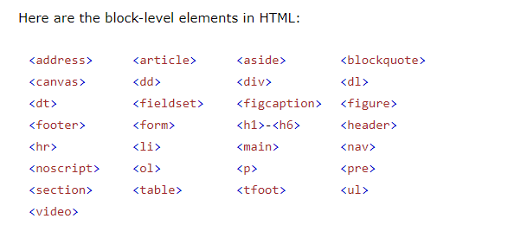
Block-level Elements
A block-level element always starts on a new line, and the browsers automatically add some space (a margin) before and after the element.
A block-level element always takes up the full width available (stretches out to the left and right as far as it can).
Two commonly used block elements are: <p> and <div>.
The <p> element defines a paragraph in an HTML document.
The <div> element defines a division or a section in an HTML document.

Slide 46
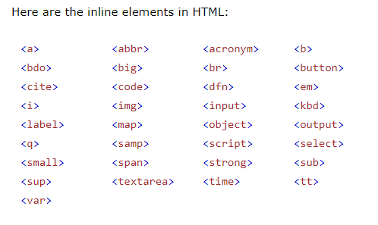
Inline Elements
An inline element does not start on a new line.
An inline element only takes up as much width as necessary.

Slide 47
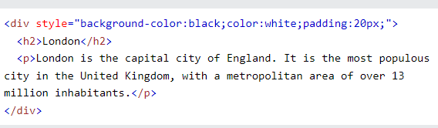
The <div> Element
The <div> element is often used as a container for other HTML elements.
The <div> element has no required attributes, but style, class and id are common.
When used together with CSS, the <div> element can be used to style blocks of content:

Slide 48
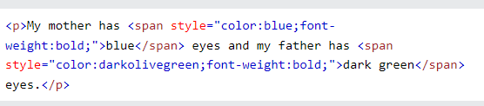
The <span> Element
The <span> element is an inline container used to mark up a part of a text, or a part of a document.
The <span> element has no required attributes, but style, class and id are common.
When used together with CSS, the <span> element can be used to style parts of the text:

Slide 49
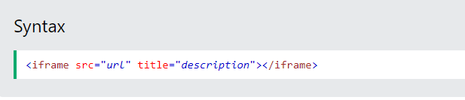
HTML Iframes
An HTML iframe is used to display a web page within a web page.
The HTML <iframe> tag specifies an inline frame.
An inline frame is used to embed another document within the current HTML document.
It is a good practice to always include a title attribute for the <iframe>. This is used by screen readers to read out what the content of the iframe is.

Slide 50


Iframe - Set Height and Width
Use the height and width attributes to specify the size of the iframe.
The height and width are specified in pixels by default:
Or you can add the style attribute and use the CSS height and width properties:

Slide 51
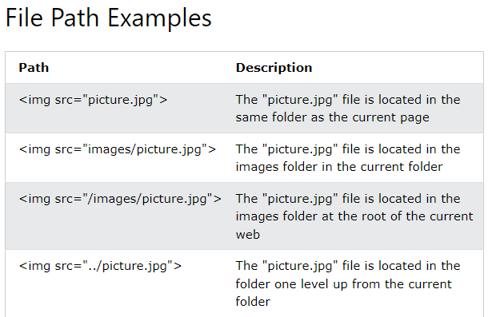
HTML File Paths
A file path describes the location of a file in a web site's folder structure.

Slide 52
HTML File Paths
A file path describes the location of a file in a web site's folder structure.
File paths are used when linking to external files, like:
Web pages
Images
Style sheets
JavaScripts

Slide 53
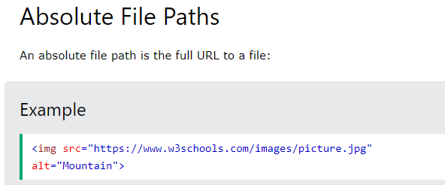
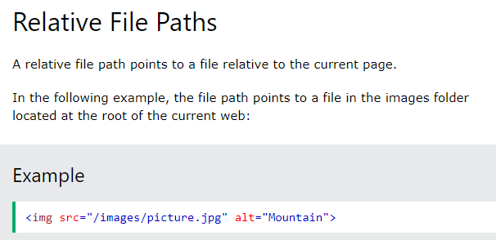
Absolute vs Relative File Path

Slide 54
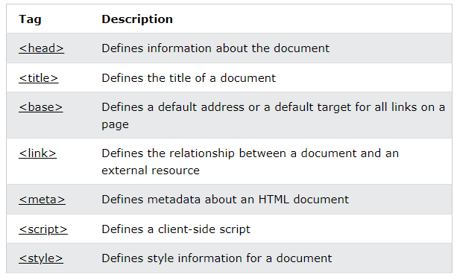
HTML - The Head Element
The HTML <head> element is a container for the following elements: <title>, <style>, <meta>, <link>, <script>, and <base>.

Slide 55
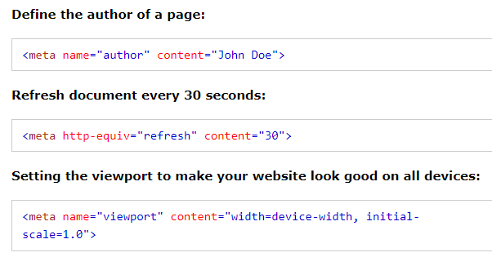
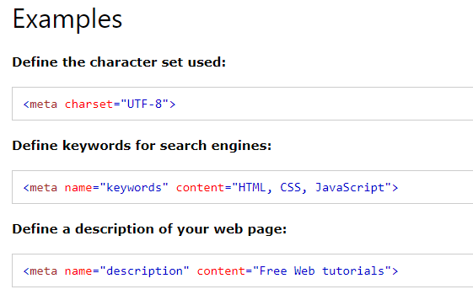
The HTML <meta> Element
The <meta> element is typically used to specify the character set, page description, keywords, author of the document, and viewport settings.
The metadata will not be displayed on the page, but is used by browsers (how to display content or reload page), by search engines (keywords), and other web services.

Slide 56
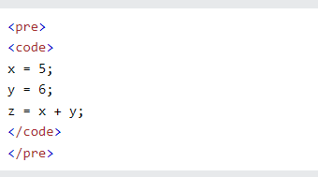
HTML Computer Code Elements
HTML contains several elements for defining user input and computer code.

Slide 57
HTML Semantic Elements
Semantic elements = elements with a meaning.
A semantic element clearly describes its meaning to both the browser and the developer.
Examples of non-semantic elements: <div> and <span> - Tells nothing about its content.
Examples of semantic elements: <form>, <table>, and <article> - Clearly defines its content.

Slide 58
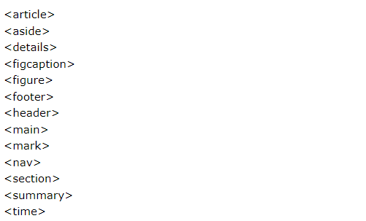
Semantic Elements in HTML
Many web sites contain HTML code like: <div id="nav"> <div class="header"> <div id="footer"> to indicate navigation, header, and footer.
In HTML there are some semantic elements that can be used to define different parts of a web page:

Slide 59
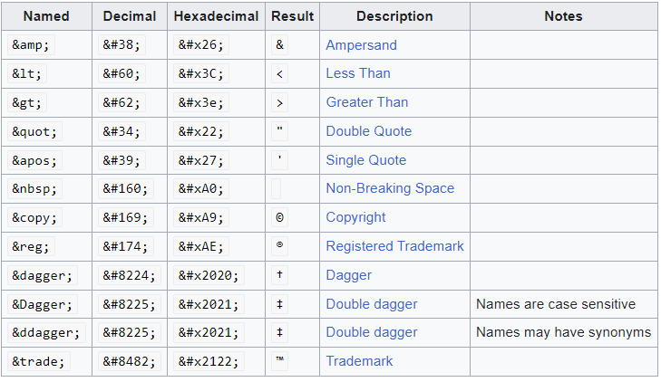
HTML Entities
Reserved characters in HTML must be replaced with character entities.
Some characters are reserved in HTML.
If you use the less than (<) or greater than (>) signs in your text, the browser might mix them with tags.
Character entities are used to display reserved characters in HTML.

Slide 60
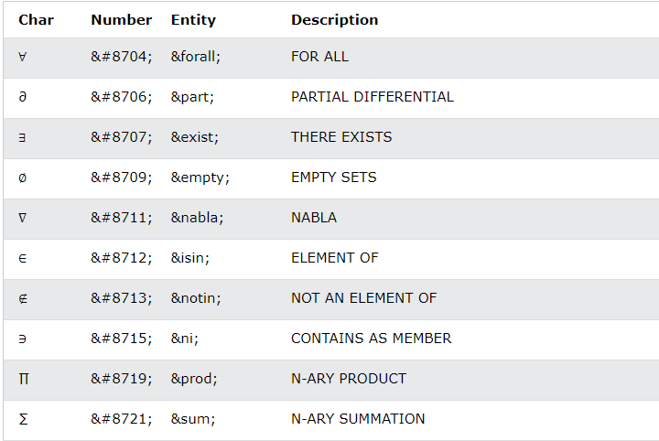
HTML Symbols
Symbols that are not present on your keyboard can also be added by using entities.
HTML entities were described in the previous chapter.
Many mathematical, technical, and currency symbols, are not present on a normal keyboard.
To add such symbols to an HTML page, you can use the entity name or the entity number (a decimal or a hexadecimal reference) for the symbol.

Slide 61
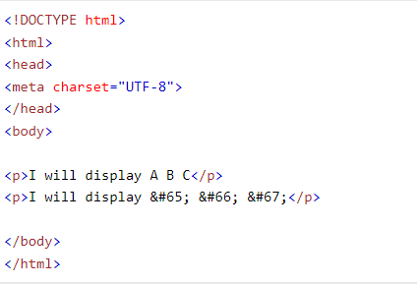
Using Emojis in HTML
Emojis are characters from the UTF-8 character set: 😄 😍 💗
Emojis look like images, or icons, but they are not.
They are letters (characters) from the UTF-8 (Unicode) character set.
Many UTF-8 characters cannot be typed on a keyboard, but they can always be displayed using numbers (called entity numbers):
A is 65
B is 66
C is 67

Slide 62
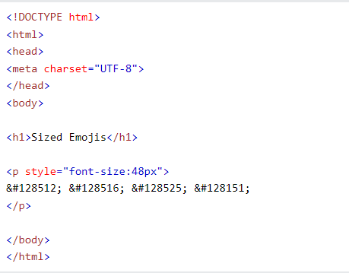
Emoji Characters
Emojis are also characters from the UTF-8 alphabet:
😄 is 128516
😍 is 128525
💗 is 128151

Slide 63
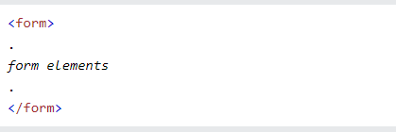
HTML Forms
An HTML form is used to collect user input. The user input is most often sent to a server for processing.
The HTML <form> element is used to create an HTML form for user input:

Slide 64
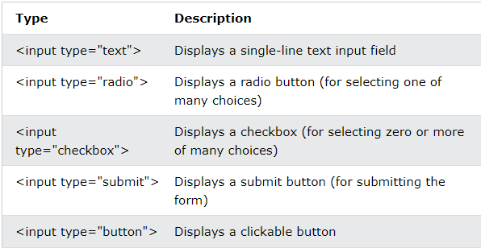
The <input> Element
The HTML <input> element is the most used form element.
An <input> element can be displayed in many ways, depending on the type attribute.

Slide 65
The <label> Element
The <label> tag defines a label for many form elements.
The <label> element is useful for screen-reader users, because the screen-reader will read out loud the label when the user focuses on the input element.
The <label> element also helps users who have difficulty clicking on very small regions (such as radio buttons or checkboxes) - because when the user clicks the text within the <label> element, it toggles the radio button/checkbox.
The for attribute of the <label> tag should be equal to the id attribute of the <input> element to bind them together.

Slide 66
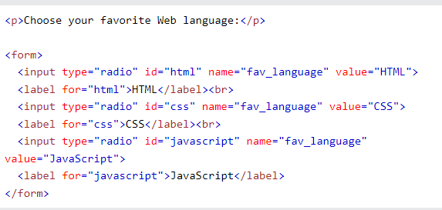
Radio Buttons
The <input type="radio"> defines a radio button.
Radio buttons let a user select ONE of a limited number of choices.

Slide 67
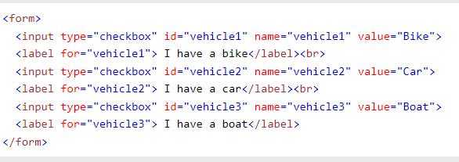
Checkboxes
The <input type="checkbox"> defines a checkbox.
Checkboxes let a user select ZERO or MORE options of a limited number of choices.

Slide 68

The Submit Button
The <input type="submit"> defines a button for submitting the form data to a form-handler.
The form-handler is typically a file on the server with a script for processing input data.
The form-handler is specified in the form's action attribute.

Slide 69

HTML Form Attributes - The Action Attribute
The action attribute defines the action to be performed when the form is submitted.
Usually, the form data is sent to a file on the server when the user clicks on the submit button.
In the example below, the form data is sent to a file called "action_page.php". This file contains a server-side script that handles the form data:

Slide 70


HTML Form Attributes - The Method Attribute
The method attribute specifies the HTTP method to be used when submitting the form data.
The form-data can be sent as URL variables (with method="get") or as HTTP Post transaction (with method="post").
The default HTTP method when submitting form data is GET.

Slide 71
HTML Method Attribute – GET
Appends the form data to the URL, in name/value pairs
NEVER use GET to send sensitive data! (the submitted form data is visible in the URL!)
The length of a URL is limited (2048 characters)
Useful for form submissions where a user wants to bookmark the result
GET is good for non-secure data, like query strings in Google

Slide 72

HTML Method Attribute – POST
Appends the form data inside the body of the HTTP request (the submitted form data is not shown in the URL)
POST has no size limitations, and can be used to send large amounts of data.
Form submissions with POST cannot be bookmarked

Slide 73

The <select> Element
The <select> element defines a drop-down list:
The <option> element defines an option that can be selected.
By default, the first item in the drop-down list is selected.
To define a pre-selected option, add the selected attribute to the option:

Slide 74

The <select> Element - Visible Values:
Use the size attribute to specify the number of visible values:

Slide 75

The <select> Element - Allow Multiple Selections:
Use the multiple attribute to allow the user to select more than one value:

Slide 76

The <textarea> Element
The <textarea> element defines a multi-line input field (a text area):
The rows attribute specifies the visible number of lines in a text area.
The cols attribute specifies the visible width of a text area.

Slide 77

The <button> Element
The <button> element defines a clickable button:

Slide 78

The <fieldset> and <legend> Elements
The <fieldset> element is used to group related data in a form.
The <legend> element defines a caption for the <fieldset> element.

Slide 79

The <datalist> Element
The <datalist> element specifies a list of pre-defined options for an <input> element.
Users will see a drop-down list of the pre-defined options as they input data.
The list attribute of the <input> element, must refer to the id attribute of the <datalist> element.

Slide 80

HTML Form Input - The size Attribute
The input size attribute specifies the visible width, in characters, of an input field.
The default value for size is 20.
Note: The size attribute works with the following input types: text, search, tel, url, email, and password.

Slide 81
HTML SVG Graphics
SVG defines vector-based graphics in XML format.
SVG stands for Scalable Vector Graphics
SVG is used to define graphics for the Web
SVG is a W3C recommendation
The HTML <svg> Element
The HTML <svg> element is a container for SVG graphics.
SVG has several methods for drawing paths, boxes, circles, text, and graphic images.

Slide 82


SVG Circle

Slide 83
HTML Multimedia
Multimedia on the web is sound, music, videos, movies, and animations.
Multimedia comes in many different formats. It can be almost anything you can hear or see, like images, music, sound, videos, records, films, animations, and more.
Web pages often contain multimedia elements of different types and formats.
Note: Only MP3, WAV, and Ogg audio are supported by the HTML standard.

Slide 84

HTML Video
The HTML <video> element is used to show a video on a web page.
The controls attribute adds video controls, like play, pause, and volume.

Slide 85

HTML <video> Autoplay & Muted
Add muted after autoplay to let your video start playing automatically (but muted):

Slide 86

HTML Audio
The HTML <audio> element is used to play an audio file on a web page.
To play an audio file in HTML, use the <audio> element
The controls attribute adds audio controls, like play, pause, and volume.
Notes:
The text between the <audio> and </audio> tags will only be displayed in browsers that do not support the <audio> element.

Slide 87

HTML <audio> Autoplay & Muted
To start an audio file automatically, use the autoplay attribute:
Add muted after autoplay to let your audio file start playing automatically (but muted):

Slide 88
THANK YOU

